Slide 1
Phase 2 Theia Presentation
Presented By:
-Musa Husseini
-Nathan Brown
-Dylan Meyer
-Abhilash Ambati
-Tucker Surdock
Notes:
Musa

Slide 2
Prototype Features
Home Screen:
3 button interface
Push the destination button and say where you want to go.
Push the emergency button and it will dial the 9-1-1
Push the settings button and it will take you to the settings screen
Settings Screen:
User information where they can enter their first and last name
Emergency Contact information where they can list their first and last name along with their phone number

Slide 3
Prototype Features
Caretaker Hub Screen:
The caretaker can enter in destinations, time of day, and day of the week of when a user is meant to be at a location
There will be a list of saved routes the user can view, edit, and delete. As long as the routes are saved Theia will instruct the user to navigate to those destination.
Configuration Screen:
Either user or caretaker are manually change the settings or change them through speaking to the application

Slide 4
Scenario 1
AS-IS
Stevie is trying to go to his next classroom. He knows he needs to walk ahead a few steps, and then turn left around the corner.
However, he is not sure when to turn.
He took a guess, but turned too early, hit the wall and hurt his head.
TO-BE
The THEIA app asks Stevie to give his current location and the destination.
The app calculates the route from the current location to the destination.
THEIA tells Stevie to “walk ahead 10 steps, then turn left.”
Notes:
Tucker

Slide 5
Scenario 2
AS-IS
Frank is walking somewhere in his office building while after hours.
Frank trips and is unable to get back up.
Unfortunately, nobody is around to help so Frank is stuck where he is for a good while until someone shows up.
TO-BE
Frank had entered their destination using the Theia app.
They still trip, and nobody is around to help.
Frank presses the emergency call button on the interface, the Theia app asks to confirm his selection, and then places a call.
Help is able to arrive much faster than if Frank had been left alone.
Notes:
Tuckerr

Slide 6
Scenario 3
AS-IS
Martha’s son Greg is blind.
When Greg has to go to school, Martha cannot be around her son to ensure Greg is able to get to his classes safely.
She is troubled whenever she gets a call from the school telling her her son had difficulty getting to class on time.
TO-BE
Martha installs the THEIA app onto her son’s phone.
Using the caretaker configurations, she is able to input her son’s class locations and what times his classes will be at.
The app is able to recommend these destinations to Greg at the desired times in order to give him directions exactly when he needs them.
Notes:
Musa

Slide 7
Top Priority
Being able to accept the user’s location input and calculate a list of instructions to tell the user is the highest priority scenario to fulfil.
The system must be able to accept vocal input otherwise the system will not be sufficiently usable for our primary stakeholders. Additionally, data must be created such as previous input locations and times, or average movement speed. This information is critical to provide user’s the most comfortable experience possible.
It is also helpful to notify the user of changes to the recommended locations list based on past usage or caretaker configurations.
However, if the app is unable to get user input and calculate the route then the entire system will fall flat.
Notes:
Musa

Slide 8

Function Points and Creeping Rate
Internal Logical Files:
User preferences - 2pt
Navigation history - 2pt
User statistics (including avg pace) - 2pt
External Logical Files:
Maps of buildings - 6pts
External Inputs:
User voice operation - 5pts
Destination, including building, floor, room, etc. - 4pts
Caretaker one-time setup - 2pt
External Outputs:
Directions to destination - 5pts
External Inquiries:
Prompt for destination - 3pt
Prompt to choose one of multiple routes - 4pt
Creeping Rate
Estimated initial function points: 35
Estimated ending function points: 40
Rate assuming 2 month work time:
Notes:
Nathan

Slide 9
Why use Theia?
Why should you choose our model?
Able to navigate unfamiliar areas and entirely new buildings without help.
No worry about getting lost or ending up in the wrong room.
Able to interact with Theia entirely through voice commands.
No need for a caretaker or stranger to escort you.
Simple, three button design for quick access to key features while being comprehensible to blind users
Easy to use caretaker settings to include new favorite routes and easily adjust preferences for users.
Usage of both button and vocal input to appeal to a larger range of user abilities.
Notes:
Dylan

Slide 10
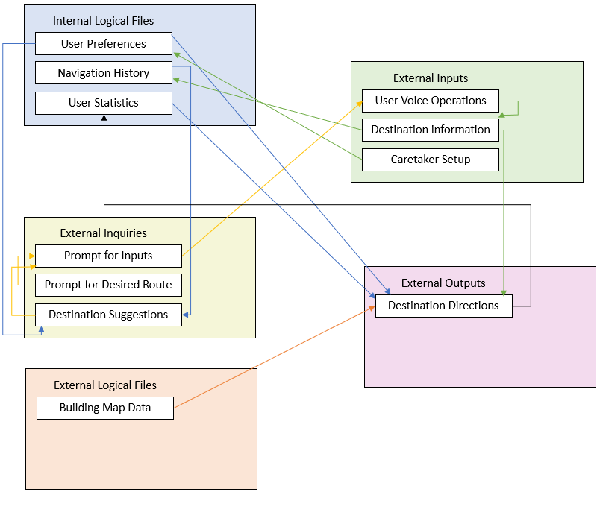
Block Diagram Overview
Notes:
Dylan

